Slide 1

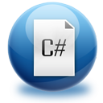
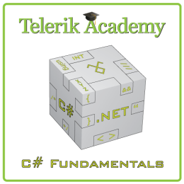


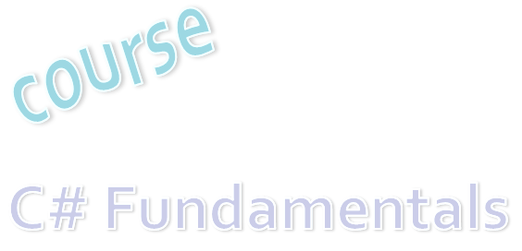
C# Programming Course – Part I
About the Course
Svetlin Nakov
Manager Technical Training
www.nakov.com
Telerik Software Academy
academy.telerik.com

Slide 2



Table of Contents
About Telerik and the Software Academy
"Software Academy" Training Program
Course Objectives & Course Program
Trainers Team
Examination
Learning Resources
Requirements for All Trainees
C# programming

Slide 3
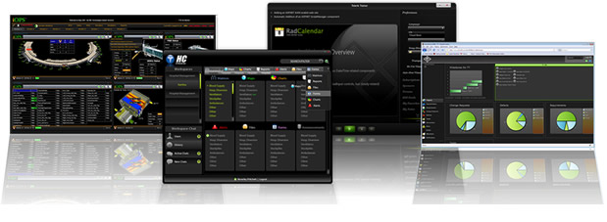


About Telerik
What Makes Telerik so Successful?

Slide 4

About Telerik
What does Telerik do?
Software development productivity tools
ASP.NET AJAX and MVC, Silverlight, WPF, WP7, Win8 and HTML5 components, ORM, Reporting, CMS Solutions, Productivity Tools, Testing Tools, Agile PM Tools, Mobile Dev Tools
Headquartered in Bulgaria
With offices in USA, Germany, Australia, India
650 employees – mostly developers
Employer #1 in Bulgaria for 2010

Slide 5

Why Telerik is Successful?
Hard Work
Essential to the success of any company
Good People
The greatest capital of the company
Constant Improvement
Adaptive to changes
Open Communication
Everyday we get feedback and improve our products and work processes

Slide 6
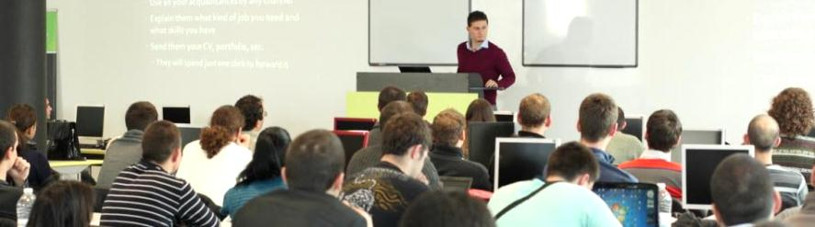

Telerik Academy
Free Trainings for Software Engineers

Slide 7
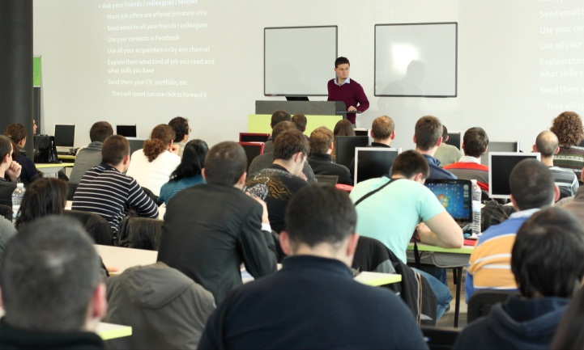
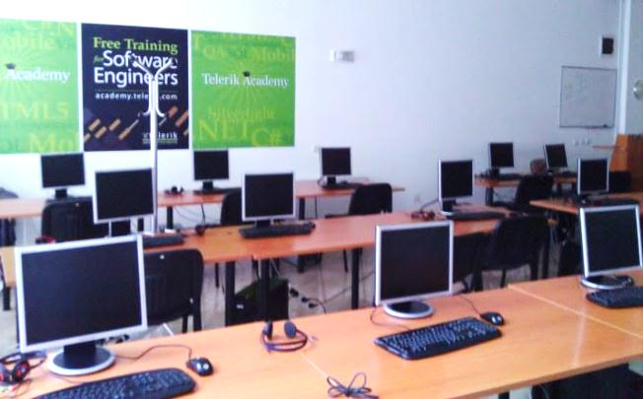

About Telerik Academy
Telerik Academy is an initiative for free training young software engineers
Software Academy: .NET Devs, Web & XAML Front-Ends, QAs, Dev-Supports
Kids Academy
School Academy
Algo Academy
Online Courses
Contests and free initiatives

Slide 8
Learning Tracks
Kids Academy
Online Courses
School Academy
Algo Academy
Software Academy
C# Programming
Web Front-End
.NET Dev.
QA
Front-End
Dev. Support
Job at Telerik
Another Job

Slide 9



"Software Academy" Program
What is It? How It Works? The Learning Tracks

Slide 10
The “Software Academy” Program @ Telerik
Become a skillful software engineer for free
It takes 6-12 months (~ full time job)
Learning, homework, projects, team work
Web development track (HTML5, JavaScript, …)
Programming track (C#, OOP, DB, …)
Professional tracks
.NET Developer, QA, Support Engineer, Web Front-End, XAML Front-End, ASP.NET Dev, Mobile Dev, Windows 8 Dev, Cloud Dev, …

Slide 11
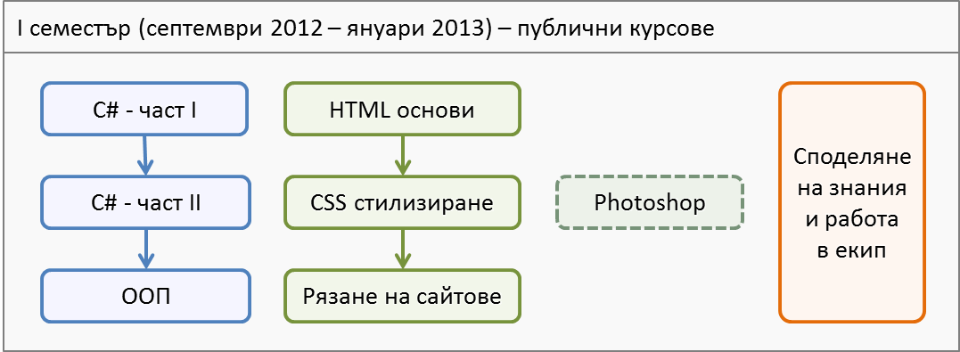
Software Academy: First Semester
The 1st semester
C# programming and Web technologies basics
3-4 times weekly, 4 hours in class + homework

Slide 12
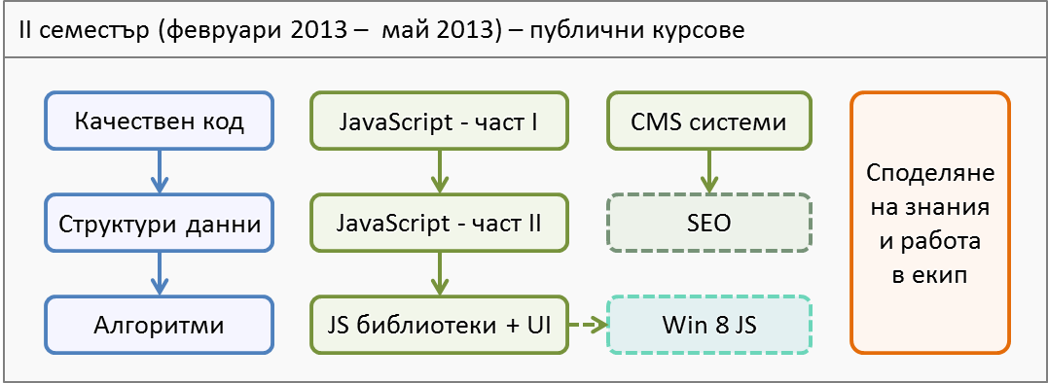
Software Academy: Second Semester
The 2nd semester
Advanced C# and JavaScript programming
3-4 times weekly, 4 hours in class + homework

Slide 13
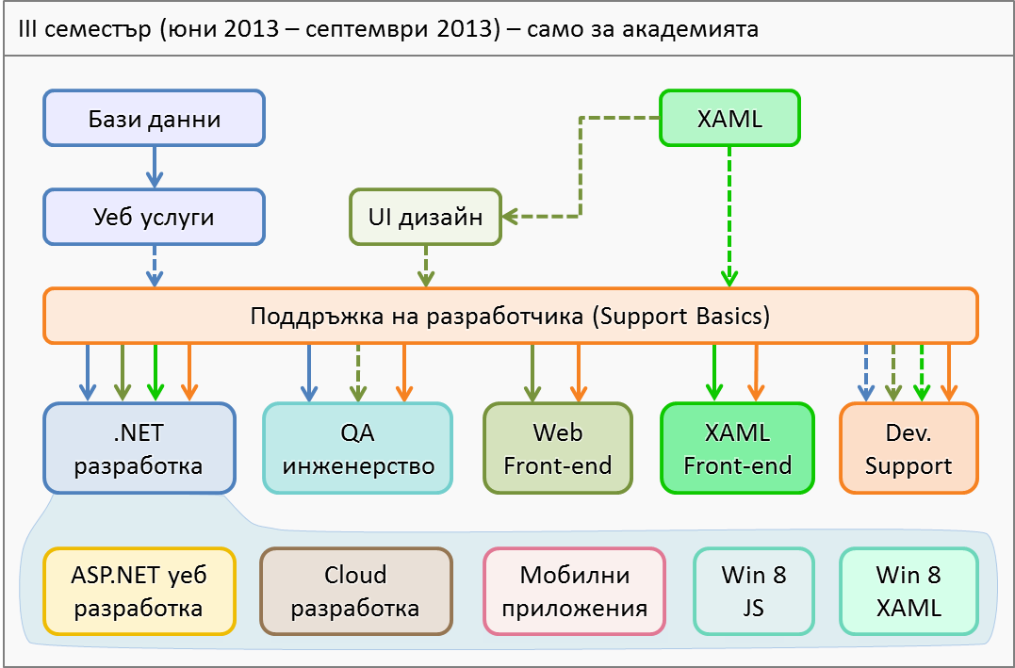
Software Academy: Third Semester
Full time – 5 times weekly, 8 hours in class

Slide 14
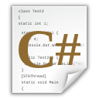


C# Programming: Objectives & Program
What Topics Shall We Cover?

Slide 15
C# Course Objectives
The C# Programming track at the Academy:
Give the trainees the fundamental computer programming knowledge and skills
Establish the logical and algorithmic thinking
Development of problems solving skills
Learn basic data structures, algorithms and object-oriented programming (OOP) concepts
Learn to produce high-quality code
Prepare for learning the software technologies
HTML5, DB & SQL, ASP.NET, XAML, Win8, …

Slide 16
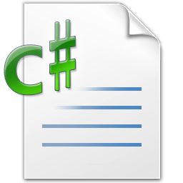
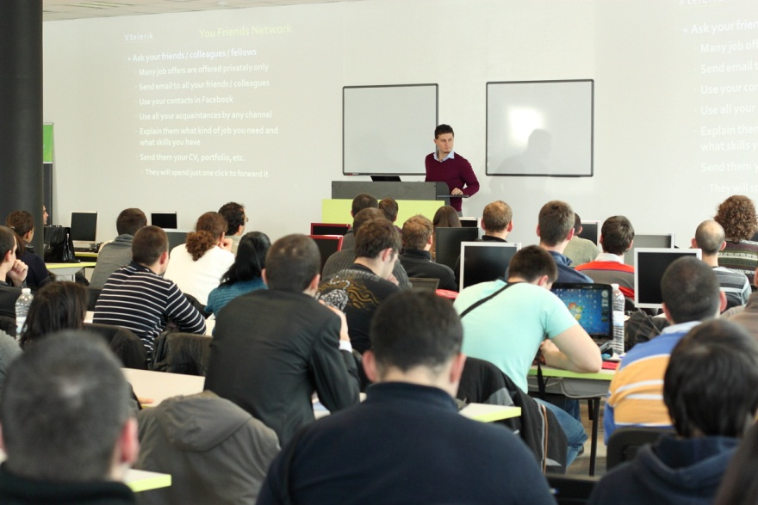
C# Part I – Course Topics
Introduction to Programming
Primitive Data Types and Variables
Operators, Expressions and Statements
Console Input / Output
Conditional Statements
Loops
Exam Preparation
C# Programming Test
C# Practical Exam

Slide 17
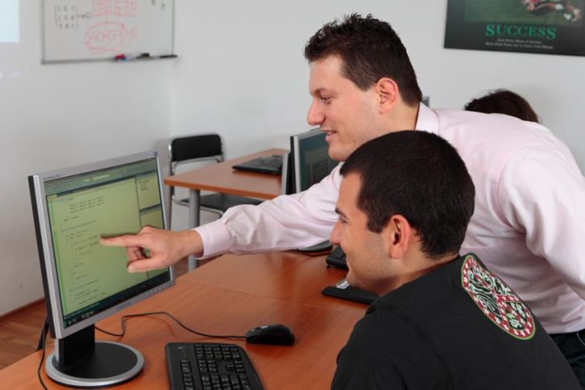
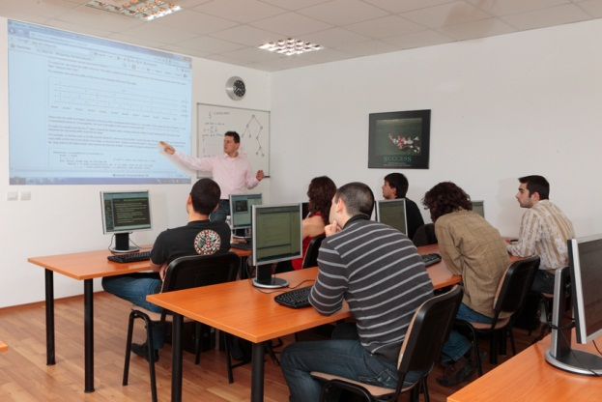
C# Part II – Course Topics
Arrays and Matrices
Numeral Systems
Methods
Creating and Using Objects
Strings and Text Processing
Problem Solving Methodology
Exam Preparation
C# Programming Test
C# Practical Exam

Slide 18
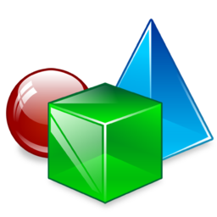

OOP – Course Topics
Object-Oriented Programming Basics
Defining Classes: Constructors, Visibility
Defining Classes: Fields, Properties, Methods
Exceptions Handling
OOP Principles: Abstraction, Encapsulation, Inheritance, Polymorphism
Interfaces, Abstract Classes, Templates, Indexers
OO Modeling with UML
Team Work: Creating OOP Game
OOP Exam Preparation
OOP Test and Practical Exam

Slide 19

High-Quality Code – Topics
Definition of High-Quality Code. Entrance Project
Naming the Identifiers. Code Formatting
High-Quality Classes. High-Quality Methods
Correct Usage of Variables, Constants, Conditional Statements and Loops
Defensive Programming and Exceptions
Code Documentation and Self-Documenting Code
Unit Testing and Test-Driven Development (TDD)
Code Refactoring. Refactoring Patterns
Practical Project & Defense

Slide 20
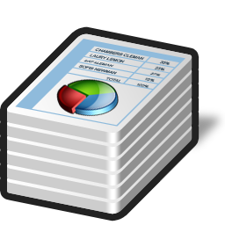
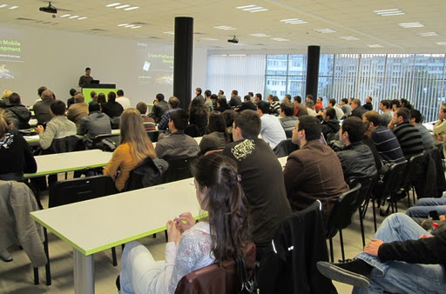

Data Structures – Topics
Data Structures – Introduction
Linear Data Structures
Trees and Graphs. Balanced Search Trees
Dictionaries, Hash-Tables and Sets
Complexity of Algorithms. Data Structures Efficiency
Exam Preparation
Practical Exam

Slide 21
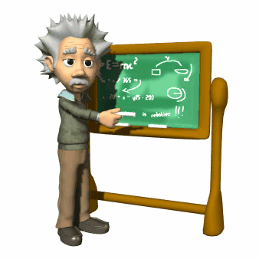

Algorithms – Topics
Algorithms – Introduction
Sorting Algorithms
Searching Algorithms
Dynamic Programming
Recursion and Combinatorial Algorithms
Graph and Tree Algorithms
Other Algorithms: Greedy, Geometry, Randomized, Genetic, …
Problem Solving Methodology
Exam Preparation & Practical Exam

Slide 22
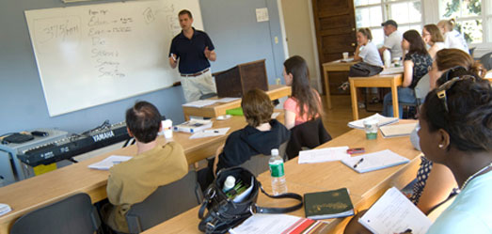
Trainers Team

Slide 23
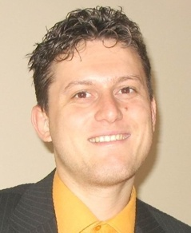
Trainers Team
Svetlin Nakov, PhD
Manager Technical Training @ Telerik Software Academy
20 years software development experience
10+ years experience as trainer
Author of 6 books
Speaker at hundreds of events
E-mail: svetlin.nakov [at] telerik.com
Web site / Blog: http://nakov.com

Slide 24
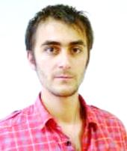
Trainers Team (2)
Doncho Minkov
Technical Trainer @ Telerik Software Academy
Student in Sofia University
Software Engineering
Contestant in the Informatics competitions
Graduate from the first season of Telerik Software Academy
Email: doncho.minkov [at] telerik.com
Blog: http://minkov.it

Slide 25

Trainers Team (3)
Nikolay Kostov
Technical Trainer @ Telerik Corp.
Student in Sofia University
Computer Science
Contestant in the IT and Informatics competitions
Graduate from the second season of Telerik Software Academy
Email: nikolay.kostov [at] telerik.com
Blog: http://nikolay.it

Slide 26
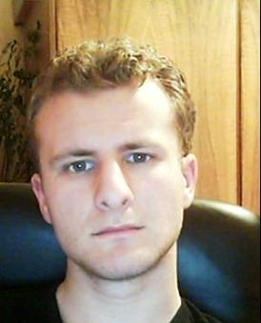
Trainers Team (4)
George Georgiev
Technical Trainer @ Telerik Corp.
Informatics and IT competitions contestant and winner
Student in Sofia University
Software engineering
Graduate from the third season of Telerik Software Academy
E-mail: georgi.georgiev [at] telerik.com
Blog: http://itgeorge.net

Slide 27
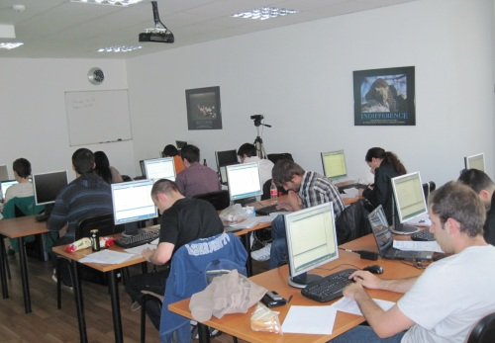
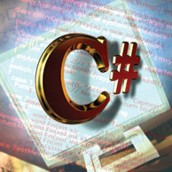
C# Programming Course – More Details
Duration, Languages, Technologies

Slide 28

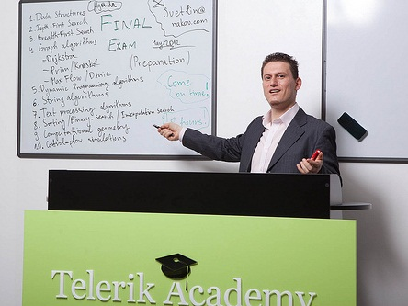
Training Duration – C# Part I
Lectures: ~ 15 hours
Practical exercises: ~ 20 hours
Homework: ~ 40-60 hours
Test: 1 hour
Exam: 6 hours
Allocation
C# Part I: ~ 1-2 month @ 1-2 times weekly, 4 hours
C# Part II: ~ 1 month @ 2 times weekly, 4 hours

Slide 29

Why C# and .NET Framework?
Microsoft is very strong industry leader
.NET Framework and C# are the primary development technologies in the MS ecosystem
The C# language
Modern object-oriented language
Widespread and very popular
Easy to learn
Most Telerik products target the .NET platform

Slide 30


Why English?
Why the slides are in English?
English is the native language of the software engineers
Just learn it!
Specific terminology should be in English
Translations are inaccurate and funny

Slide 31
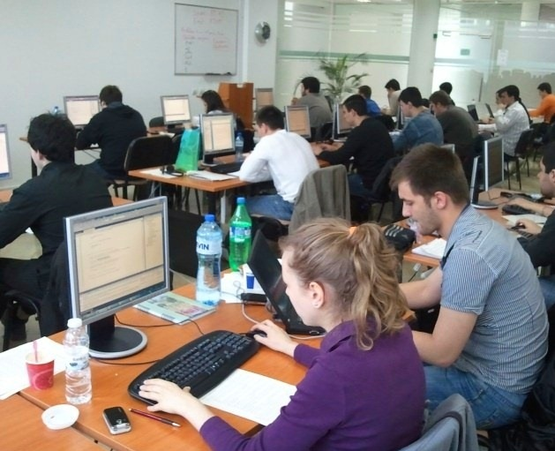
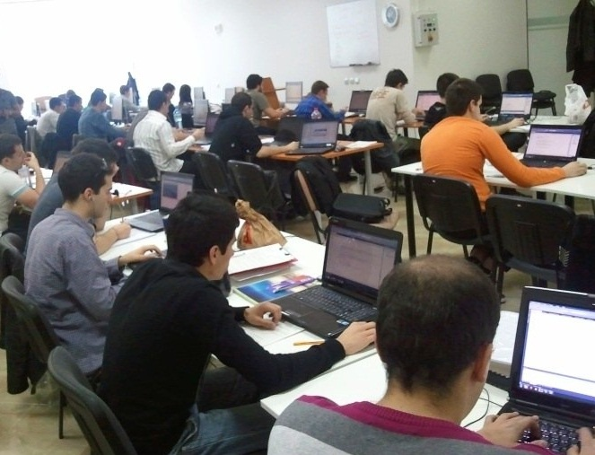
C# Part I Exams
Test & Examination Criteria

Slide 32

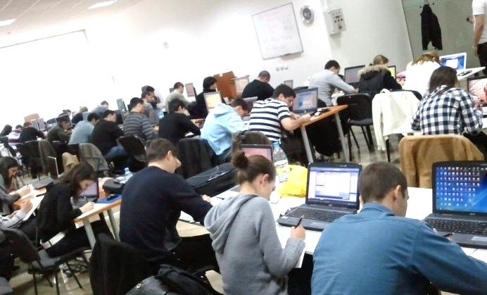
Exams @ Software Academy
Exams measure the individual performance
Serve as filter for the most skillful people
Score formed by many components:
Test and exam results, forums activity, homework, lectures attendance, etc.

Slide 33
Scoring System for C# Part I
Attendance – 10%
Test – 25%
Serves as primary pass / fail criteria for the course
Exam – 50%
Homework – 15%
Forums activity – bonus up to 10%
PC Magazine & Telerik Contest – bonus up to 10%
Helping the other students – bonus up to 10%
Knowledge sharing / blogging – bonus up to 20%

Slide 34
C# Part I Exams
C# Programming Test
30 questions for 1 hour
Choose the correct among few answers
Best students pass to the practical (real) exam
Practical Programming Exam
3-5 practical problems for 6 hours
Covers all learned topics up to the moment
Automated judge system & real-time feedback
Solutions are evaluated for correctness only

Slide 35
C# Test – Sample Question
You are given the following C# code:
What will be the output?
static void Main()
{
int n = 5;
int m = 7;
int result = n / m * 3;
Console.WriteLine(result);
}
3
2.142857
0
4.2
compilation error
runtime error

Slide 36
Pass / Fail / Excellence Criteria
C# Part I – pass / fail / excellence criteria:
Test
Very low results → fail (course not taken)
Average results → pass (course taken)
High results → practical exam
Practical exam
High results → pass with excellence
Low results → pass

Slide 37
C# Exam – Sample Problem
Write a program that enters a positive integer number N from the console and prints two symmetric triangles of size N separated by a vertical line, just like in the examples below:
N = 1
|
* | *
N = 2
|
* | *
** | **
N = 3
|
* | *
** | **
*** | ***
N = 5
|
* | *
** | **
*** | ***
**** | ****
***** | *****

Slide 38
The Judge System at the Exam
All exams will be tested automatically
Through our online judge system (BG Coder)
During the exam preparation you will practice how to use the automated judge system
You can register at any time to practice
How the testing (judge) system works?
You submit your C# source code
It tests your solution against predefined tests
For each test passed you get some score

Slide 39
Homework Assignments
Doing your homework is very important!
Programming can only be learned through a lot of practice!
After each lecture there are few exercises
Try to solve them in class
The rest are your homework
Homework assignments are due in 1-2 weeks after each lecture
Submission will be accepted through the student's system: telerikacademy.com

Slide 40








Resources
What We Need in Addition to this Course Content?

Slide 41

The C# Textbook
The official textbook for the course
“Introduction to Programming with C#”, Nakov S. and his team, 2010
Freely downloadable from: www.introprogramming.info
The C# programming tracks follows the book
C# Part I → chapters 1..6 (up to Loops)

Slide 42
Course Web Site & Forums
Register for the "Telerik Academy Forums":
Discuss the course exercises with your colleagues
Find solutions for the exercises
Share source code / discuss ideas
The C# Part I official web site:
forums.academy.telerik.com/csharp-fundamentals
http://academy.telerik.com/student-courses/ programming/csharp-programming-part-1/

Slide 43
Telerik Integrated Learning System (TILS)
The Telerik Integrated Learning System (TILS)
www.telerikacademy.com
Important resource for all students
Homework submissions
Calendar
Presence cards with barcode
Reports about your results
Etc.

Slide 44


Required Software
Software needed for this course:
Microsoft Windows (XP / Win7 / Win8)
Microsoft Visual Studio 2012 or Visual Studio Express 2012 (free version of VS 2012)
.NET Framework 4.5 (included in Visual Studio)
Visual Studio 2005, 2008 or 2010 is also OK

Slide 45
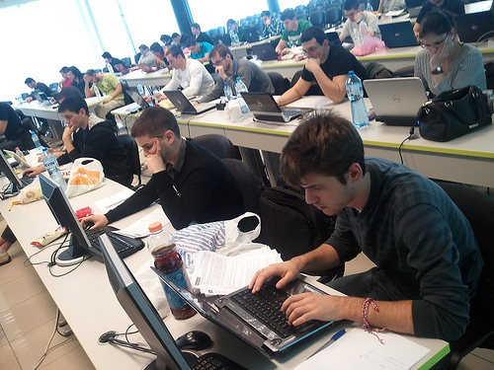

Requirements for All Trainees
The Training Program Requires 100% Commitment!

Slide 46

Requirements for All Trainees
Basic computer skills
We don’t teach computer literacy
English
Ability to read technical documentation in English is enough
Very serious attitude
Long-term commitment
8 hours / day (average)

Slide 47

Full Commitment
Key factors for succeeding in the Software Academy Training Program
Solid motivation & attitude
Willingness for very hard work!
“Cheaters” are not welcome
All your time
50% in class (for the lectures and exercises)
50%-500% at home (for the homework)
All your energy for knowledge sharing

Slide 48

Invest in Yourself!
Invest in yourself!
Invest in your training!
Invest in your skills development!
… Unless you consider yourself a bad investment. Do you?

Slide 49
C# Programming Course – Part I
http://academy.telerik.com

Slide 50


Free Trainings @ Telerik Academy
Fundamentals of C# Programming Track of Courses
csharpfundamentals.telerik.com
Telerik Software Academy
academy.telerik.com
Telerik Academy @ Facebook
facebook.com/TelerikAcademy
Telerik Software Academy Forums
forums.academy.telerik.com

